Slide 1

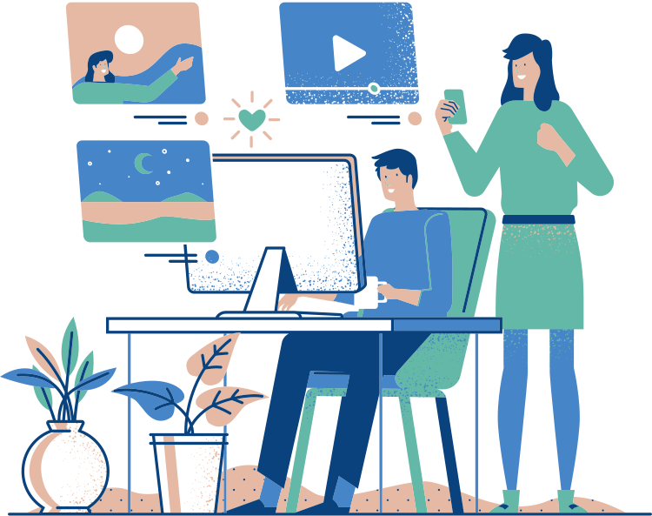
Digital Minimalists
Quality Engineering
November 27, 2019
Jesus Roa, Merve Pekdemir,
Angela Yao, Stefan Luong

Slide 2


Problem
Average American spends 5 hours a day on their phones
https://online.king.edu/news/cell-phone-addiction/

Slide 3


So what can we do to minimize the amount of time we spend on our phones?
Design of Experiment
2³ Full Factorial with 8 replicates

Slide 4








Our 3 Factors
Based on these commonly recommended strategies:
https://www.inc.com/yazin-akkawi/7-ways-to-curb-your-smartphone-addiction-right-now.html
Social Media
Grayscale
Unlock Difficulty
vs.
Disable apps vs. Enable apps
Turn on Grayscale
vs.
Turn off Grayscale
8+ Digit passcode
Touch Unlock/ Facial Recognition

Slide 5
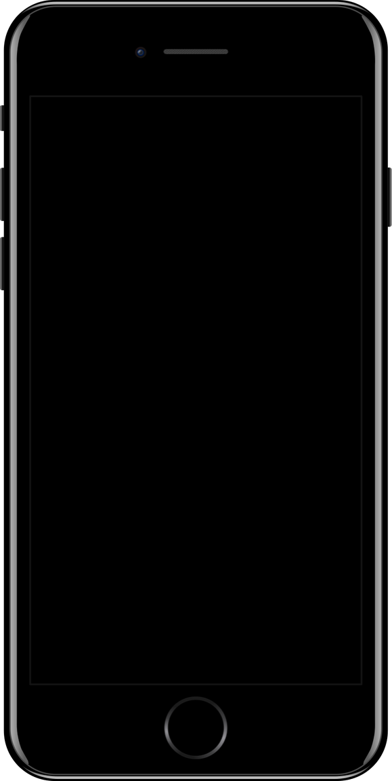


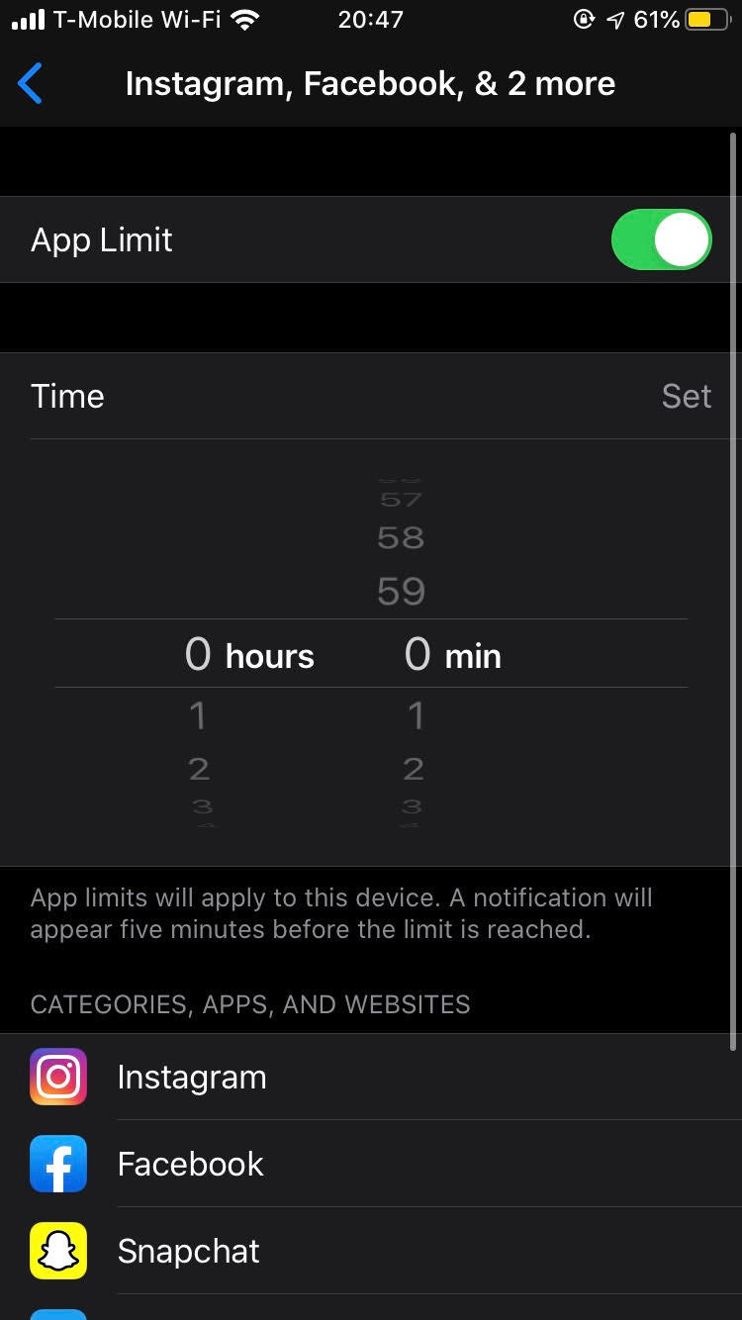




Factor #1: Social Media
Disable following apps with timer:
We enabled messaging apps:
Facebook Messenger
GroupMe

Slide 6
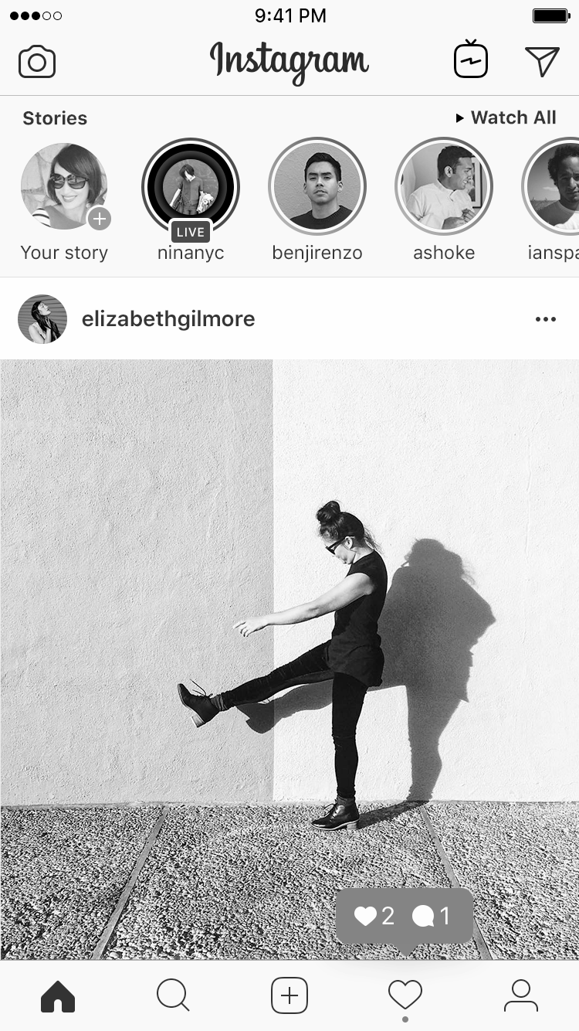
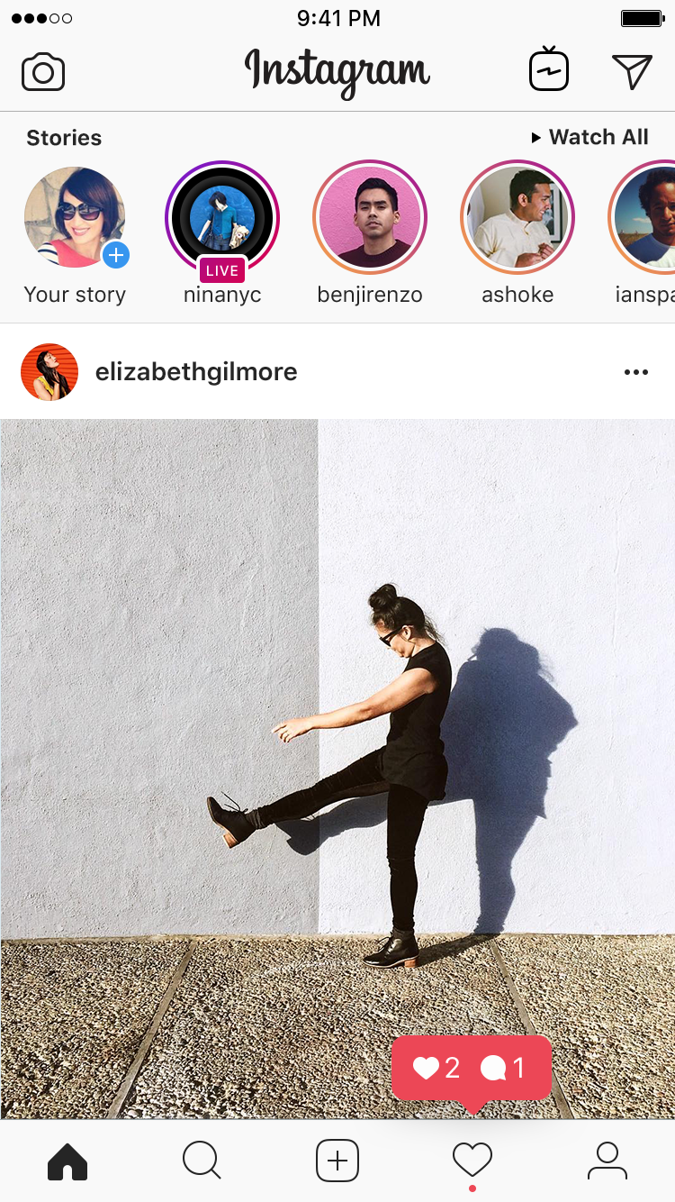
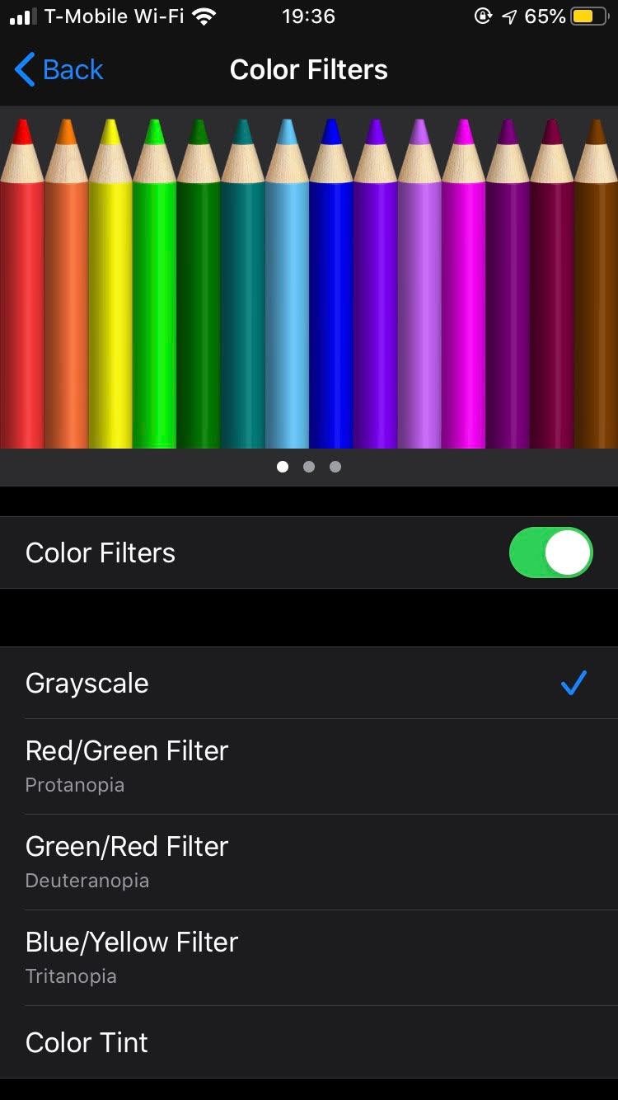
Factor #2: Grayscale
ON
OFF

Slide 7

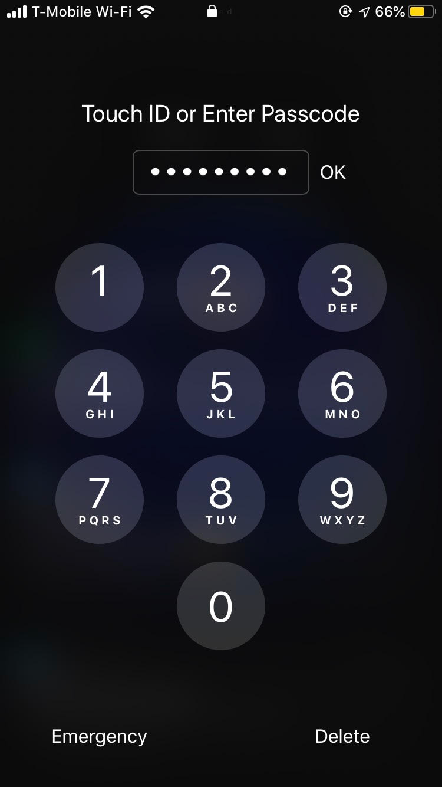

Factor #3: Unlock Difficulty
EASY
Face ID
Touch ID
HARD
8+ Digit Passcode

Slide 8
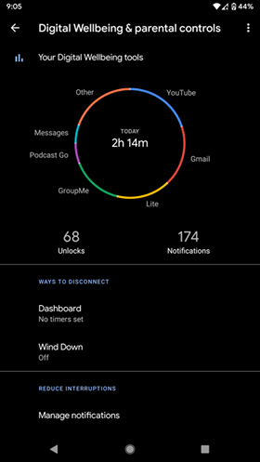
Measuring performance: Screentime
Data from October 8 to October 29 on weekdays
Randomized run order
Run for 16 days
Measured screen time between 8AM until 9PM

Slide 9
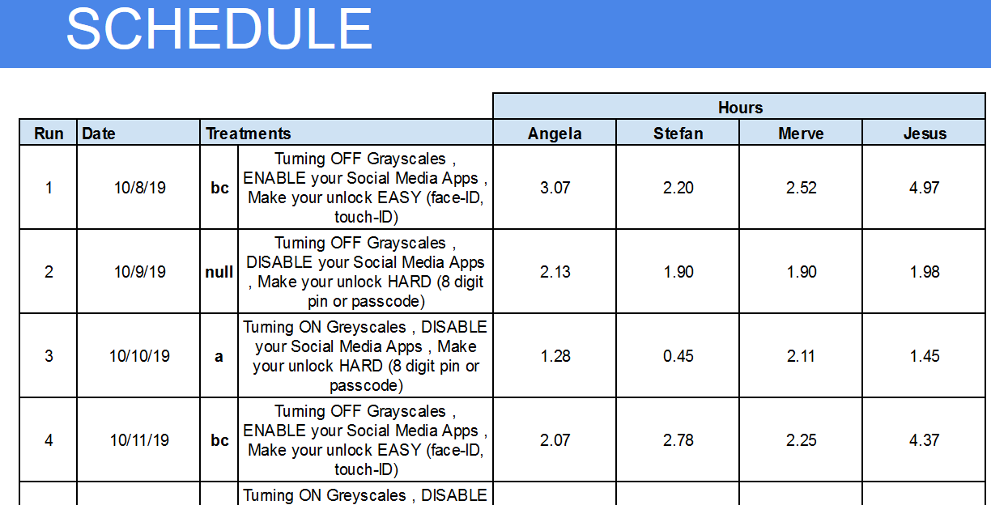
Tracking Process:

Slide 10
What can we do to minimize the time we spend on our phones?
Reduce Social Media
Don’t bother with lock screen or greyscale

Slide 11


Analysis

Slide 12

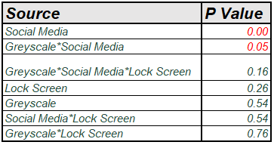


Social Media is most significant
Screentime (Hrs)= 2.12 + 0.41*Social Media
- 0.06 * Grayscale + 0.10 * Lock Screen
- 0.18*Grayscale*Social Media
+ 0.03 * Lock Screen * Grayscale
+ 0.06 * Social Media * Lock Screen
Social Media and Greyscale interaction also significant!

Slide 13
R square of reduced model is okay
Screentime = 2.12 + 0.41 * Social Media - 0.18 * Greyscale * Social Media
2 hrs 7 min
25 min
11 min
Source | P Value
Social Media | 0.00
Grayscale * Social Media | 0.05
Summary of Fit
RSquare | 0.28
RSquare Adj | 0.26
RMS Error | 0.72

Slide 14
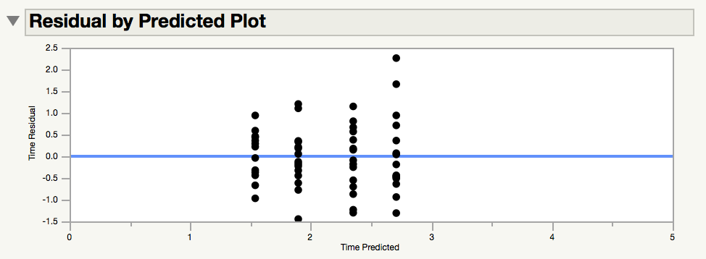
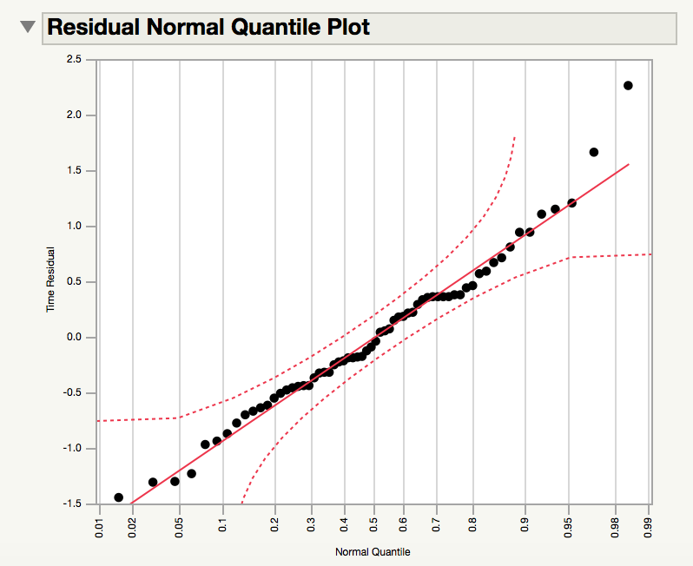
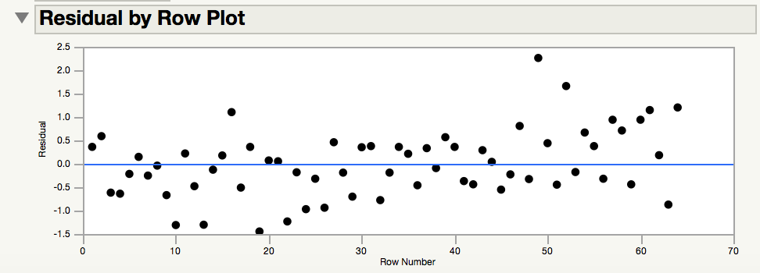
Reduced Model: Residuals are acceptable

Slide 15
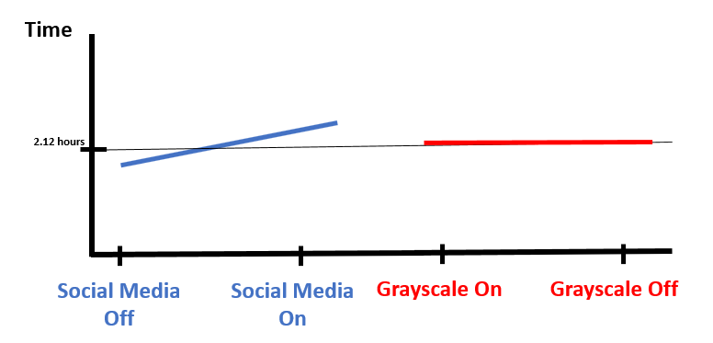
Social media is only significant effect
Reduced model: Main Effects
We see Social Media has a significant effect
Grayscale, however, seems insignificant

Slide 16
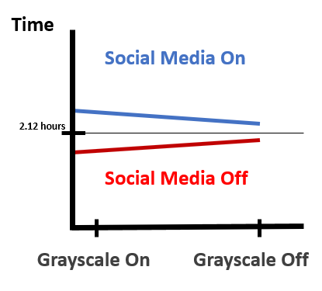
Turning Social Media OFF is best
Interaction Effects
If social media is off, turning grayscale ON can help
When social media is ON and grayscale ON, time increases...WHY?
P=0.05

Slide 17
Validation Experiment

Slide 18


Our model is validated!
Prediction Interval: [1.15, 3.35] hours
Our validation runs:
2.83 hours - within Prediction Interval!
2.45 hours - within Prediction Interval!

Slide 19


Given more time...
Larger and more diverse phone user base
Longer period of time
Weekends and day of the week
Computer usage for total screen time
Phone games, email, boredom, and social media posts as factors

Slide 20

Conclusion
No social media is best
32% reduction
Lock screen and grayscale effects were overshadowed by noise
Phone use is extremely personal

Slide 21
Thank you!

Slide 22
Appendix

Slide 23
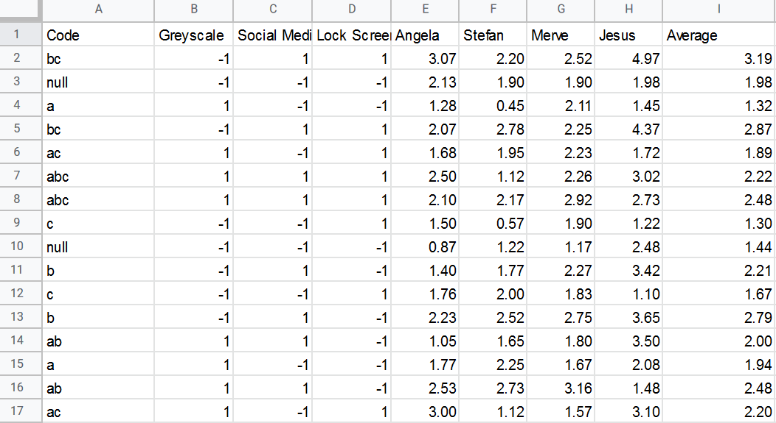

Slide 24
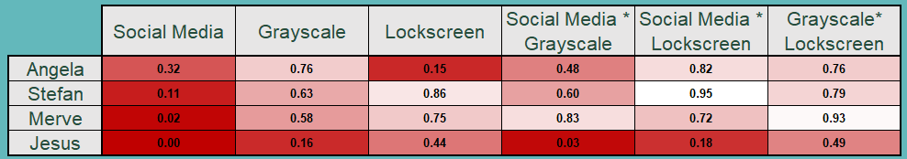
Model Per Person: P-Values

Slide 25
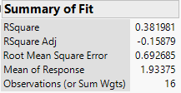
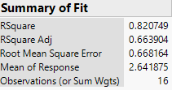
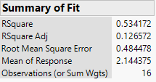
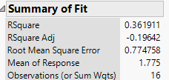

Model Per Person: Rsqrd
Stefan
Angela
Jesus
Merve

Slide 26
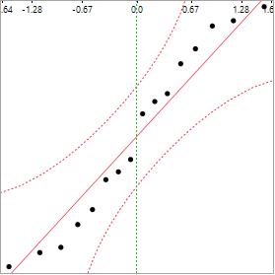
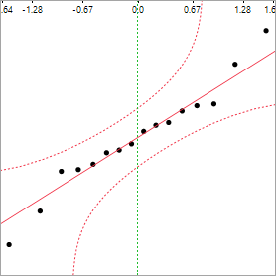
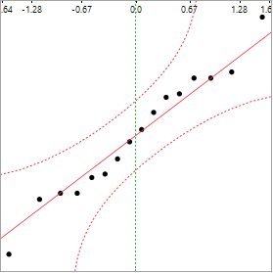
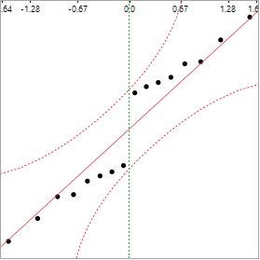
Model Per Person: Residuals
Stefan
Angela
Jesus
Merve

Slide 27
Alternative Reduced Model
Screentime = 2.12 + 0.41 * Social Media
2 hrs 7 min
25 min
Source | P Value
Social Media | 0.00
Summary of Fit
RSquare | 0.23
RSquare Adj | 0.22
RMS Error | 0.75

Slide 28
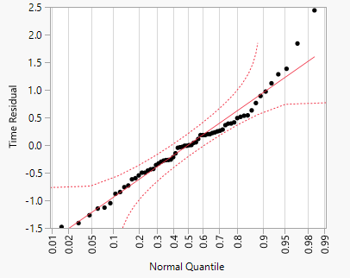
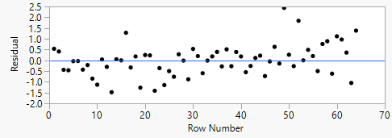
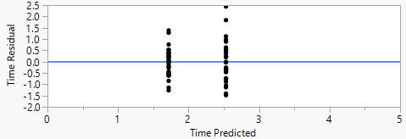
Alternative Reduced Model

Slide 29
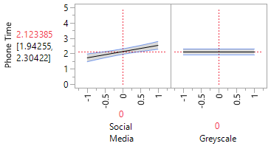
Main Effect Graph for reduced Model: Original output from JMP
Social media is only significant effect
Reduced model: Main Effects
We see Social Media has a significant effect
Grayscale, however, seems insignificant

